Slide 1

CSE- 321
Software Engineering
Lecture: 09 System modeling and UML
Fahad Ahmed
Lecturer, Dept. of CSE
E-mail: fahadahmed@uap-bd.edu

Slide 2
Lecture Outlines
Model
System Modeling
UML-Building Blocks
UML : Diagrams
Class Diagram
Object Diagram
Use case Diagram
UML Tools

Slide 3
System Modeling
What is model?
Model is a simplification of reality.
A model is an abstraction of some aspect of an existing or planned system.
Blueprint of the actual system.
Specify the structural and behavior of the system.
Templates for designing the system.

Slide 4
System Modeling
Modeling is a central part of all the activities that lead to the development of good software.
We build models to
To Communicate the desired structure and behavior of our system.
To visualize and control the systems architecture.
To better understanding the system we are building often exposing opportunities for simplification and reuse.
To manage risk.
Modeling is a proven and well accepted engineering tech.

Slide 5
Why Model ?
System Modeling
Analyse the problem-domain
simplify reality
capture requirements
visualize the system in its entirety
specify the structure and/or behaviour of the system
Design the solution
document the solution - in terms of its structure, behaviour, etc.

Slide 6
Why Model ?
System Modeling
Modeling achieves four aims:
Helps you to visualize a system as you want it to be.
Permits you to specify the structure or behavior of a system.
Gives you a template that guides you in constructing a system.
Documents the decisions you have made.
You build models of complex systems because you cannot comprehend such a system in its entirety.
You build models to better understand the system you are developing.
Notes:
According to Booch in The Unified Modeling Language User Guide, modeling achieves four aims:
1. Models help you to visualize a system, as you want it to be. A model helps the software team communicate the vision for the system being developed. It is difficult for a software team to have a unified vision of a system that is described only in specification and requirement documents. Models bring about understanding of the system.
2. Models permit you to specify the structure of behavior of a system. A model allows how to document system behavior and structure before coding the system.
3. Models give a template that guide you in constructing a system. A model is an invaluable tool during construction. It serves as a road map for a developer. Have you experienced a situation where a developer coded incorrect behavior because he or she was confused over the wording in a requirements document? Modeling helps alleviate that situation.
4. Models document the decisions you’ve made. Models are valuable tools in the long term because they give “hard” information on design decisions. You don’t need to rely on someone’s memory.
Sell the students on the value of visual modeling.
Clarify that you are discussing formal modeling, not modeling written on a white board or on the back of a napkin at lunch.

Slide 7
System Modeling
Principles of Modeling
First principle of modeling:
The choice of what models to create has a profound influence on how a problem is attacked and how a solution is shaped.
Second principle of modeling:
Every model may be expressed at different levels of precision
Notes:
According to Grady Booch, IBM Fellow, a model provides the blueprints of a system. Models may encompass detailed plans, as well as more general plans that give a 30,000-foot view of the system under construction. A good model includes those elements that are not relevant to the given level of abstraction. Every system may be described from different aspects using different models, and each model is therefore a semantically closed abstraction of the system. A model may be structural, emphasizing the organization of the system, or it may be behavioral, emphasizing the dynamics of the system.
Define what is meant by the term “model.”

Slide 8
System Modeling
Principles of Modeling
Third principle of modeling:
The best models are connected to reality.
Fourth principle of modeling:
No single model is sufficient. Every non-trivial system is best approached through a small set of nearly independent models.
Notes:
According to Grady Booch, IBM Fellow, a model provides the blueprints of a system. Models may encompass detailed plans, as well as more general plans that give a 30,000-foot view of the system under construction. A good model includes those elements that are not relevant to the given level of abstraction. Every system may be described from different aspects using different models, and each model is therefore a semantically closed abstraction of the system. A model may be structural, emphasizing the organization of the system, or it may be behavioral, emphasizing the dynamics of the system.
Define what is meant by the term “model.”

Slide 9

The Importance of Modeling
System Modeling
A model is “a complete description of a system from a particular perspective.” A model is a simplification of reality.
Notes:
According to Grady Booch, IBM Fellow, a model provides the blueprints of a system. Models may encompass detailed plans, as well as more general plans that give a 30,000-foot view of the system under construction. A good model includes those elements that are not relevant to the given level of abstraction. Every system may be described from different aspects using different models, and each model is therefore a semantically closed abstraction of the system. A model may be structural, emphasizing the organization of the system, or it may be behavioral, emphasizing the dynamics of the system.
Define what is meant by the term “model.”

Slide 10
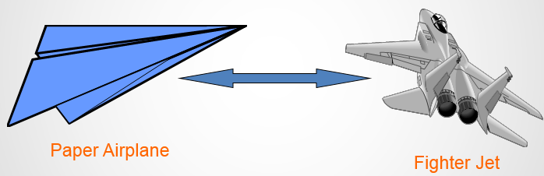
System Modeling
What are the advantages of creating a model?
Advantages: - Provides standard for software development. - Reducing of costs to develop diagrams of UML using supporting tools. - Development time is reduced. - The past faced issues by the developers are no longer exists. - Has large visual elements to construct and easy to follow.

Slide 11
System Modeling
System modeling is the process of developing abstract models of a system, with each model presenting a different view or perspective of that system.
System modeling has now come to mean representing a system using some kind of graphical notation, which is now almost always based on notations in the Unified Modeling Language (UML).
System modelling helps the analyst to understand the functionality of the system and models are used to communicate with customers.

Slide 12
Unified Modeling Language (UML)
The UML stands for Unified modeling language.
The UML is a language for
Visualizing
Specifying
Constructing
Documenting
the artifacts of a software-intensive system.
The Unified Modelling Language (UML) is an industry standard for object oriented design notation.
The Unified Modeling Language User Guide SECOND (2.0) EDITION
http://umlguide2.uw.hu/index.html

Slide 13

Unified Modeling Language (UML)
UML is not a programming language, it is rather a visual language.
We use UML diagrams to portray the behavior and structure of a system.
The UML builds models that are precise, unambiguous, and complete.
UML helps software engineers, businessmen and system architects with modelling, design and analysis.

Slide 14
Unified Modeling Language (UML)
The UML was developed in 1994-95 by Grady Booch, Ivar Jacobson, and James Rumbaugh at the Rational Software.
In 1997, it got adopted as a standard by the Object Management Group (OMG). This was the first version (V1.1) of UML. The OMG is best recognized for the Common Object Request Broker Architecture (CORBA) standards.
International Organization for Standardization (ISO) published UML as an approved standard in 2005.

Slide 15
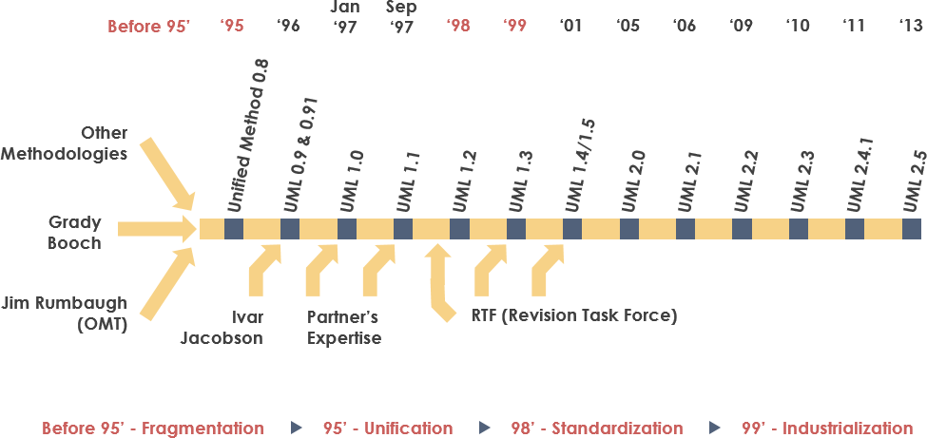
Unified Modeling Language (UML)

Slide 16
Characteristics of UML
The UML has the following features:
It is a generalized modeling language.
It is distinct from other programming languages like C++, Python, etc.
It is interrelated to object-oriented analysis and design.
It is used to visualize the workflow of the system.
It is a pictorial language, used to generate powerful modeling artifacts.

Slide 17
Where Can the UML Be Used?
The UML is intended primarily for software-intensive systems. It has been used effectively for such domains as
Enterprise information systems
Banking and financial services
Telecommunications
Transportation
Defence/aerospace
Retail
Medical electronics
Scientific
Distributed Web-based services
The UML is not limited to modeling software. In fact, it is expressive enough to model non-software systems, such as workflow in the legal system, the structure and behavior of a patient healthcare system, software engineering in aircraft combat systems, and the design of hardware.

Slide 18
Basics of the conceptual model
Some object-oriented concepts that are needed to begin with UML:
Object: An object is a real world entity. There are many objects present within a single system. It is a fundamental building block of UML.
Class: A class is a software blueprint for objects, which means that it defines the variables and methods common to all the objects of a particular type.
Abstraction: Abstraction is the process of portraying the essential characteristics of an object to the users while hiding the irrelevant information. Basically, it is used to envision the functioning of an object.

Slide 19
Basics of the conceptual model
Inheritance: Inheritance is the process of deriving a new class from the existing ones.
Polymorphism: It is a mechanism of representing objects having multiple forms used for different purposes.
Encapsulation: It binds the data and the object together as a single unit, enabling tight coupling between them.

Slide 20
UML-Building Blocks
Building Blocks of UML
Things
Relationships
Diagrams
Class, Interface,
Active class, Use case,
Component,
Collaboration, Node
Structural
Dependency,
Generalization,
Associations,
Realization
Use case,
Class,
Object,
Sequence,
Collaboration,
State chart,
Activity,
Component,
Deployment.
Behavioral
Interaction,
State Machine
Grouping
Package
Annotational
Note

Slide 21
UML-Building Blocks: Structural Things
There are 4 kinds of things in the UML
Structural Things
Behavioral Things
Grouping Things
Annotational Things
Structural Things
Structural things are the nouns of UML models. These are mostly static parts of a model, representing elements that are either conceptual or physical.
There are 7 kinds of Structural things:
Class
Interface
Collaboration
Use case
Actor
Component
Node

Slide 22
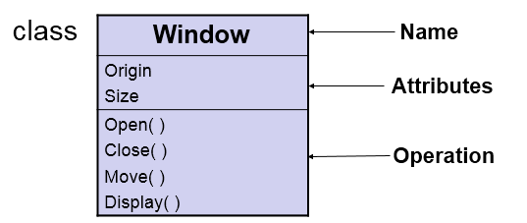
UML-Building Blocks: Structural Things
Class:-
A class is a description of a set of objects that share the same attributes, operations, relationships and semantics.
A class implements one or more interfaces.

Slide 23
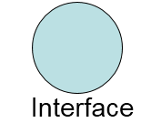
UML-Building Blocks: Structural Things
(2) Interface:-
Interface is a collection of operations that specify a service of a class or component.
An interface describes the externally visible behavior of that element.
An interface defines a set of operation specifications but never a set of operation implementations.
Graphically, an interface is represented as a circle with its name.

Slide 24
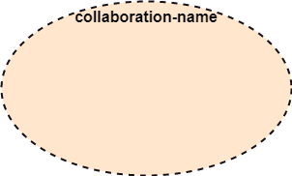
UML-Building Blocks: Structural Things
(3) Collaboration:-
A collaboration defines an interaction and is a society of roles and other elements that work together to provide some cooperative behavior.
Therefore, collaboration have structural as well as behavioral dimensions.
Graphically a collaboration is represented as an ellipse with dashed lines, usually including only its name.

Slide 25
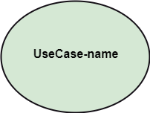
UML-Building Blocks: Structural Things
(4) Use case:-
A Use case is a description of set of sequence of actions that a system performs, which results a value to a particular actor.
A use case is used to structure the behavioral things in a model.
A use case is realized by a collaboration.

Slide 26
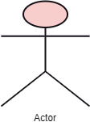
UML-Building Blocks: Structural Things
(5) Actor:-
Actor: It comes under the use case diagrams. It is an object that interacts with the system, for example, a user.

Slide 27
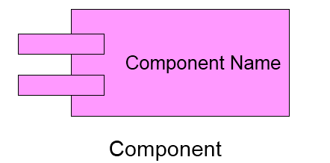
UML-Building Blocks: Structural Things
(6) Component:-
A component is a physical and replaceable part of a system that conforms to and provides the realization of a set of interfaces.
A component represents the physical packaging of logical elements such as classes, interfaces and collaborations.

Slide 28
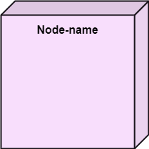
UML-Building Blocks: Structural Things
(7) Node:-
A node is physical element that exists at run-time and represents a computational resource, generally having some memory and processing capability.
A set of components may reside on a node and may also migrate from node to node.

Slide 29
UML: Behavioral Things
These are the dynamic parts of UML models.
These are the verbs of a model representing the behavior over time and space.
There are two types of behavioral things
1. Interaction
2. State machine.

Slide 30

UML: Behavioral Things
Interaction:-
An Interaction is a behavior that comprises a set of messages exchanged among a set of objects within a particular context to perform a specific purpose.
An interaction involves a number of other elements, including messages, action sequences and links. (connection between objects.)

Slide 31
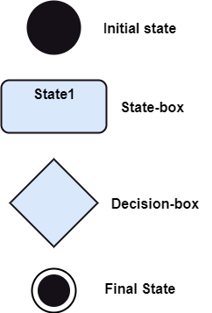
UML: Behavioral Things
(2) State machine:-
A State machine is a behavior that specifies the sequences of states an object or an interaction goes through during its lifetime in response to events, together with its responses to those events.
A State machine involves a number of other elements, including states, transitions( the flow from state to state), events (things that trigger a transition), and activities ( the response to a transition).

Slide 32
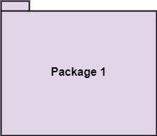
UML: Grouping Things
Grouping things are the organizational parts of UML models.
In all, there is one primary kind of grouping thing, namely, Package.
Package:-
A Package is a general-purpose mechanism for organizing elements into groups.
Structural things, behavioral things and even other grouping things that may be placed in a package.
Unlike component (which exist at run time), package is purely conceptual (meaning that it exist only at development time).

Slide 33
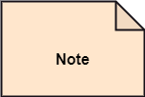
UML: Annotational Things
Annotational Things are the explanatory parts of the UML models.
These are the comments you may apply to describe, illuminate and remark about any element in a model.
There is one primary kind of Annotational thing, called a Note.
Note:- A Note is simply a symbol for representing constraints and comments attached to an element or a collection of elements.
A note is rendered as a rectangle with a
dog-eared corner.

Slide 34
Relationships in the UML
There are four kinds of relationships in the UML.
1. Dependency
2. Association
3. Generalization
4. Realization
These relationships are the basic relational building blocks of the UML. These are used to write well-formed models.

Slide 35
Relationships in the UML
DEPENDENCY:-
A Dependency is a semantic relationship between two things in which a change to one thing( the independent thing) may affect the semantics of the other thing (the dependent thing).
ASSOCIATION:-
A set of links that associates the entities to the UML model. It tells how many elements are actually taking part in forming that relationship.
It is denoted by a dotted line with arrowheads on both sides to describe the relationship with the element on both sides.

Slide 36

Relationships in the UML
GENERALIZATION:-
A generalization is a specialization/generalization relationship in which objects of the specialized elements (the child) are substitutable for objects of the generalized elements (the parent).
In this way, the child shares the structure and the behavior of the parent.
Represented as a solid line with a hollow arrow head pointing to the parent.

Slide 37

Relationships in the UML
REALIZATION:-
A realization is a semantic relationship between classifiers, wherein one classifier specifies a contract that another classifier guarantees to carryout.
We will encounter realization relationships in two places: between interfaces and classes or components that realize them, and between use cases and the collaborations that realize them.

Slide 38
UML : Diagrams
A diagram is the graphically presentation of a set of elements, most often represented as a connected graph of vertices (things) and arcs (relationships).
Diagrams visualize a system from different perspectives, so a diagram is a projection into system.
UML is linked with object oriented design and analysis.
Diagrams in UML can be broadly classified as:
Structural Diagrams
Behavior Diagrams

Slide 39
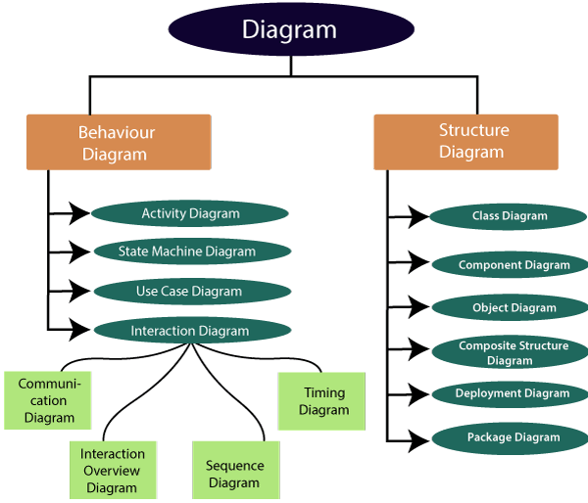
UML : Diagrams

Slide 40
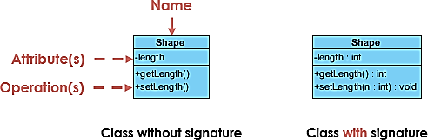
UML : Class Diagram
UML Class Diagram
The class diagram depicts a static view of an application. It represents the types of objects residing in the system and the relationships between them.
Purpose of Class Diagrams
It analyses and designs a static view of an application.
It describes the major responsibilities of a system.
It is a base for component and deployment diagrams.
It incorporates forward and reverse engineering.
Vital components of a Class Diagram
Upper Section
Middle Section
Lower Section

Slide 41
UML : Class Diagram
Cardinality
Cardinality is expressed in terms of:
one to one
one to many
many to many

Slide 42
UML : Class Diagram
How to draw a Class Diagram?
To describe a complete aspect of the system, it is suggested to give a meaningful name to the class diagram.
The objects and their relationships should be acknowledged in advance.
The attributes and methods (responsibilities) of each class must be known.
A minimum number of desired properties should be specified as more number of the unwanted property will lead to a complex diagram.
Notes can be used as and when required by the developer to describe the aspects of a diagram.
The diagrams should be redrawn and reworked as many times to make it correct before producing its final version.

Slide 43
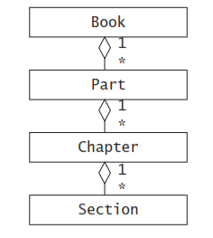
UML : Class Diagram
Draw a class diagram representing a book deﬁned by the following statement:
“A book is composed of a number of parts, which in turn are composed of a number of chapters. Chapters are composed of sections.”
Focus only on classes and relationships.
Classes are represented with rectangles.
The attribute and operations compartment can be omitted.
Aggregation relationships are represented with diamonds.
Class names start with a capital letter and are singular.

Slide 44
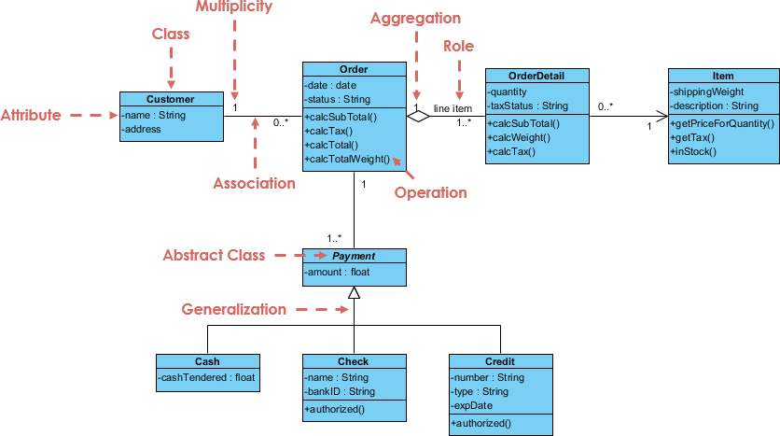
UML : Class Diagram
Class Diagram Example: Order System
https://www.uml-diagrams.org/class-diagrams-examples.html

Slide 45
UML : Object Diagram
UML Object Diagram
Object is an instance of a class in a particular moment in runtime that can have its own state and data values.
Likewise a static UML object diagram is an instance of a class diagram; it shows a snapshot of the detailed state of a system at a point in time, thus an object diagram encompasses objects and their relationships which may be considered a special case of a class diagram or a communication diagram.

Slide 46
UML : Object Diagram
Purpose of Object Diagram
The use of object diagrams is fairly limited, mainly to show examples of data structures.
During the analysis phase of a project, you might create a class diagram to describe the structure of a system and then create a set of object diagrams as test cases to verify the accuracy and completeness of the class diagram.
Before you create a class diagram, you might create an object diagram to discover facts about specific model elements and their links, or to illustrate specific examples of the classifiers that are required.

Slide 47
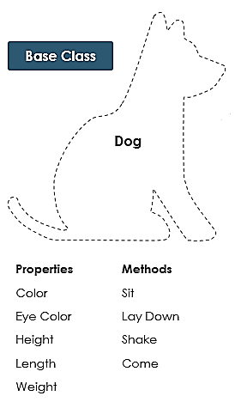
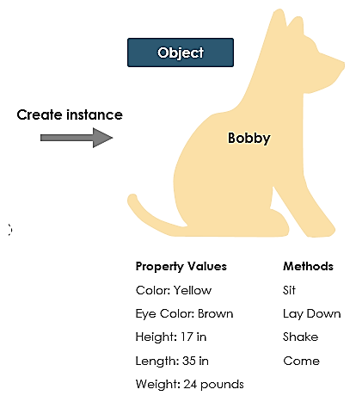
UML : Object Diagram
Dept
Name
Degree

Slide 48
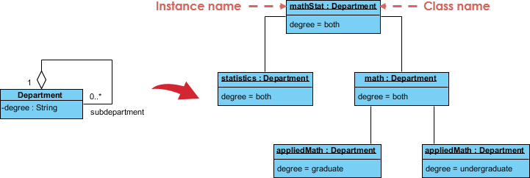
UML : Object Diagram
Class to Object Diagram
This small class diagram shows that a university Department can contain lots of other Departments and the object diagram below instantiates the class diagram, replacing it by a concrete example.

Slide 49
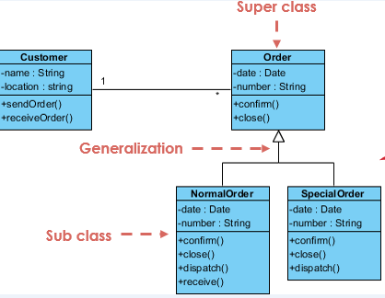
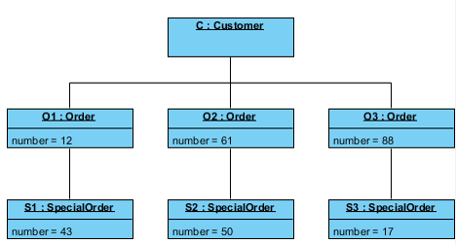
UML : Object Diagram
Class to Object Diagram

Slide 50
UML : Object Diagram
Class vs. Object diagram
SN | Class Diagram | Object Diagram
1. | It depicts the static view of a system. | It portrays the real-time behavior of a system.
2. | Dynamic changes are not included in the class diagram. | Dynamic changes are captured in the object diagram.
3. | The data values and attributes of an instance are not involved here. | It incorporates data values and attributes of an entity.
4. | The object behavior is manipulated in the class diagram. | Objects are the instances of a class.

Slide 51
UML : Use Case Diagram
Use Case Diagram
Use Case Diagram captures the system's functionality and requirements by using actors and use cases.
It only summarizes some of the relationships between use cases, actors, and systems.
It does not show the order in which steps are performed to achieve the goals of each use case.
Purpose of Use Case Diagram
Analyzing the requirements of a system
High-level visual software designing
Capturing the functionalities of a system
Modeling the basic idea behind the system
Forward and reverse engineering of a system using various test cases.

Slide 52
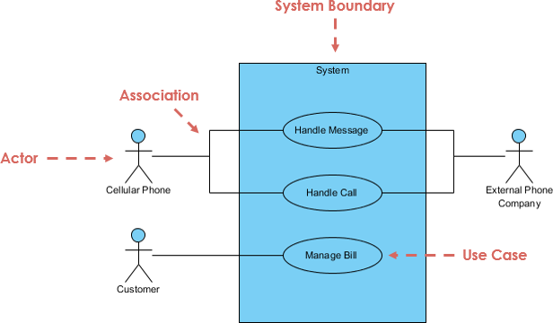
UML : Use Case Diagram
https://www.uml-diagrams.org/use-case-diagrams-examples.html
Example of Use Case Diagram

Slide 53
UML : Use Case Diagram
Example of Use Case Diagram : Bank ATM
An automated teller machine (ATM) or the automatic banking machine (ABM) is a banking subsystem (subject) that provides bank customers with access to financial transactions in a public space without the need for a cashier, clerk, or bank teller.
Customer (actor) uses bank ATM to Check Balances of his/her bank accounts, Deposit Funds, Withdraw Cash and/or Transfer Funds . ATM Technician provides Maintenance and Repairs. All these use cases also involve Bank actor whether it is related to customer transactions or to the ATM servicing.

Slide 54
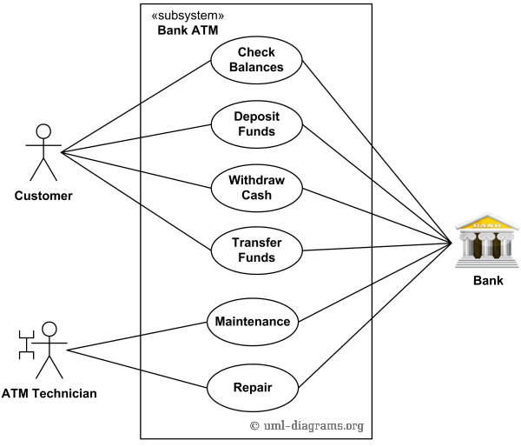
UML : Use Case Diagram
Example of Use Case Diagram : Bank ATM
Customer (actor) uses bank ATM to Check Balances of his/her bank accounts, Deposit Funds, Withdraw Cash and/or Transfer Funds. ATM Technician provides Maintenance and Repairs. All these use cases also involve Bank actor whether it is related to customer transactions or to the ATM servicing.
An example of use case diagram for Bank ATM subsystem - top level use cases.

Slide 55
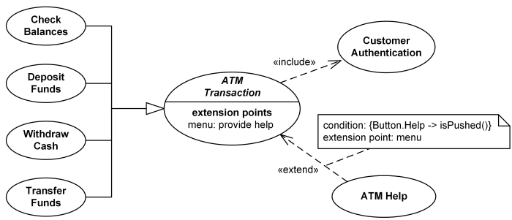
UML : Use Case Diagram
Example of Use Case Diagram : Bank ATM
On most bank ATMs, the customer is authenticated by inserting a plastic ATM card and entering a personal identification number (PIN). Customer Authentication use case is required for every ATM transaction so we show it as include relationship. Including this use case as well as transaction generalizations make the ATM Transaction an abstract use case. Customer may need some help from the ATM. ATM Transaction use case is extended via extension point called menu by the ATM Help use case whenever ATM Transaction is at the location specified by the menu and the bank customer requests help, e.g. by selecting Help menu item.
Bank ATM Transactions and Customer Authentication Use Cases Example.

Slide 56
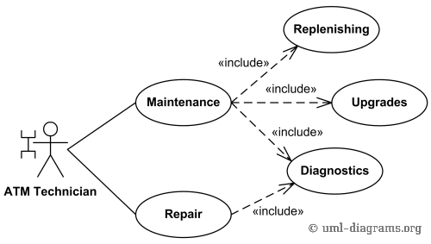
UML : Use Case Diagram
Example of Use Case Diagram : Bank ATM
ATM Technician maintains or repairs Bank ATM. Maintenance use case includes Replenishing ATM with cash, ink or printer paper, Upgrades of hardware, firmware or software, and remote or on-site Diagnostics. Diagnostics is also included in (shared with) Repair.
Bank ATM Maintenance, Repair, Diagnostics Use Cases Example

Slide 57
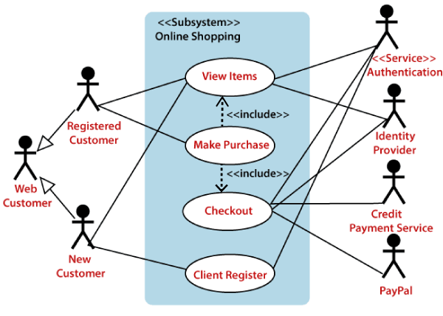
UML : Use Case Diagram
Example of Use Case Diagram

Slide 58
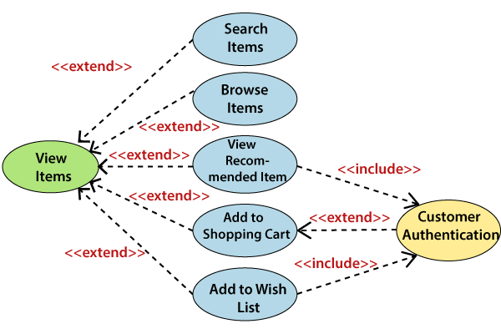
UML : Use Case Diagram

Slide 59
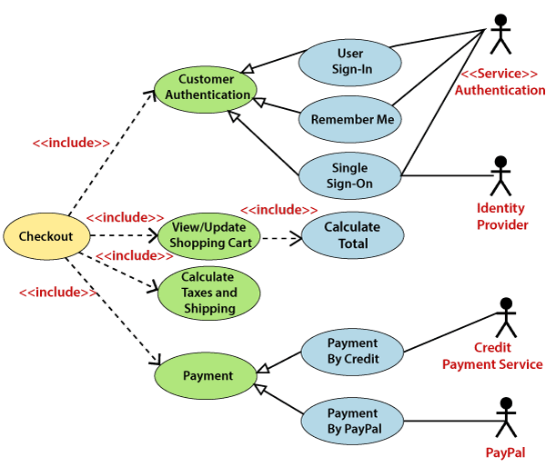
UML : Use Case Diagram

Slide 60
UML : Use Case Diagram
How to Identify Actor?
The following questions can help you identify the actors of a system.
Who uses the system?
Who installs the system?
Who starts up the system?
Who maintains the system?
Who shuts down the system?
What other systems use this system?
Who gets information from this system?
Who provides information to the system?
Does anything happen automatically at a present time?

Slide 61
UML : Use Case Diagram
How to Identify Use Cases?
The following questions can be asked to identify use cases, once your actors have been identified .
What functions will the actor want from the system?
Does the system store information?
What actors will create, read, update or delete this information?
Does the system need to notify an actor about changes in the internal state?
Are there any external events the system must know about?
What actor informs the system of those events?

Slide 62
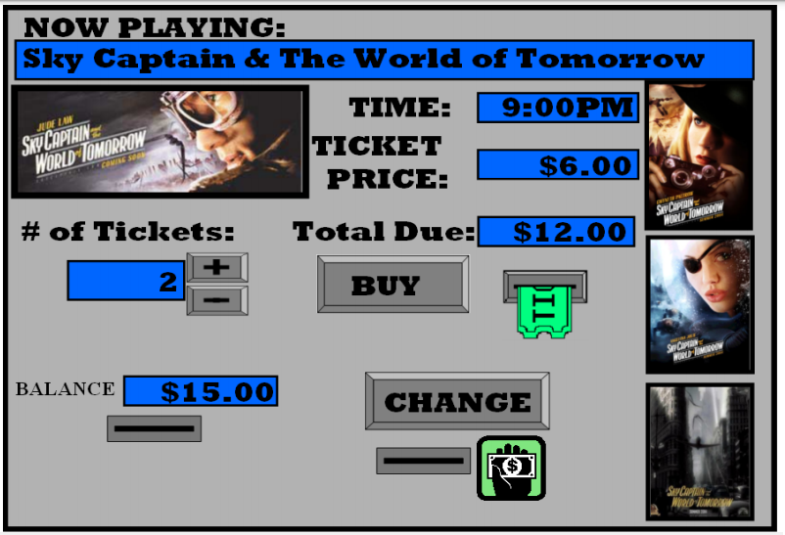
Assignment: Ticket management System

Slide 63
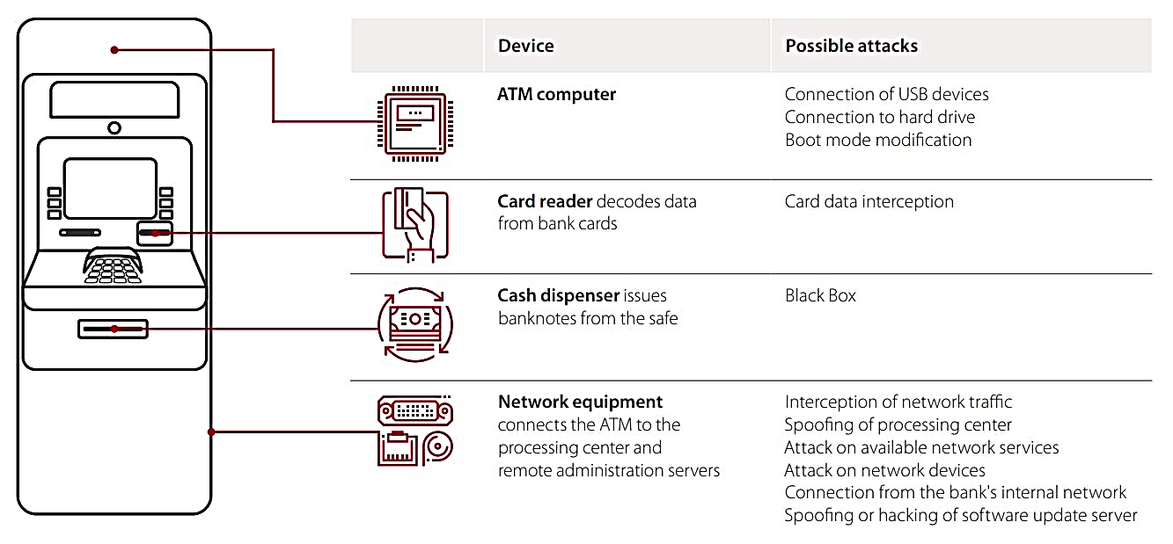
Assignment: ATM network attacks
https://www.ptsecurity.com/ww-en/analytics/atm-vulnerabilities-2018/

Slide 64
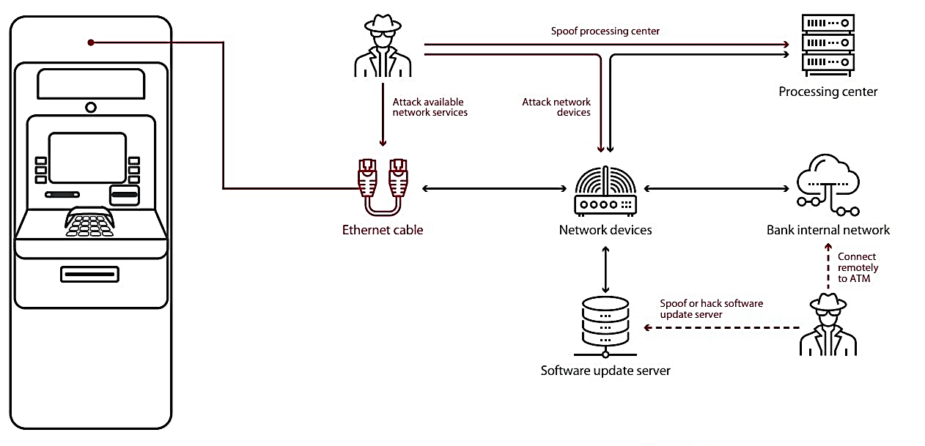
Assignment: ATM network attacks

Slide 65

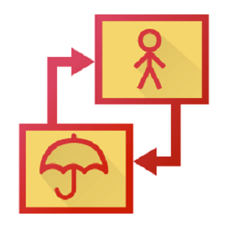
UML : Tools
UML Tools
There are numerous tools, both commercial and open-source, which are available for designing UML diagrams.
StarUML
Umbrello
Visual Paradigm
Gliffy
Altova

Slide 66

Thanks to All

